Slide 1
Megha Kapoor on Art and Painting.
Painting Process and Techniques….

Slide 2
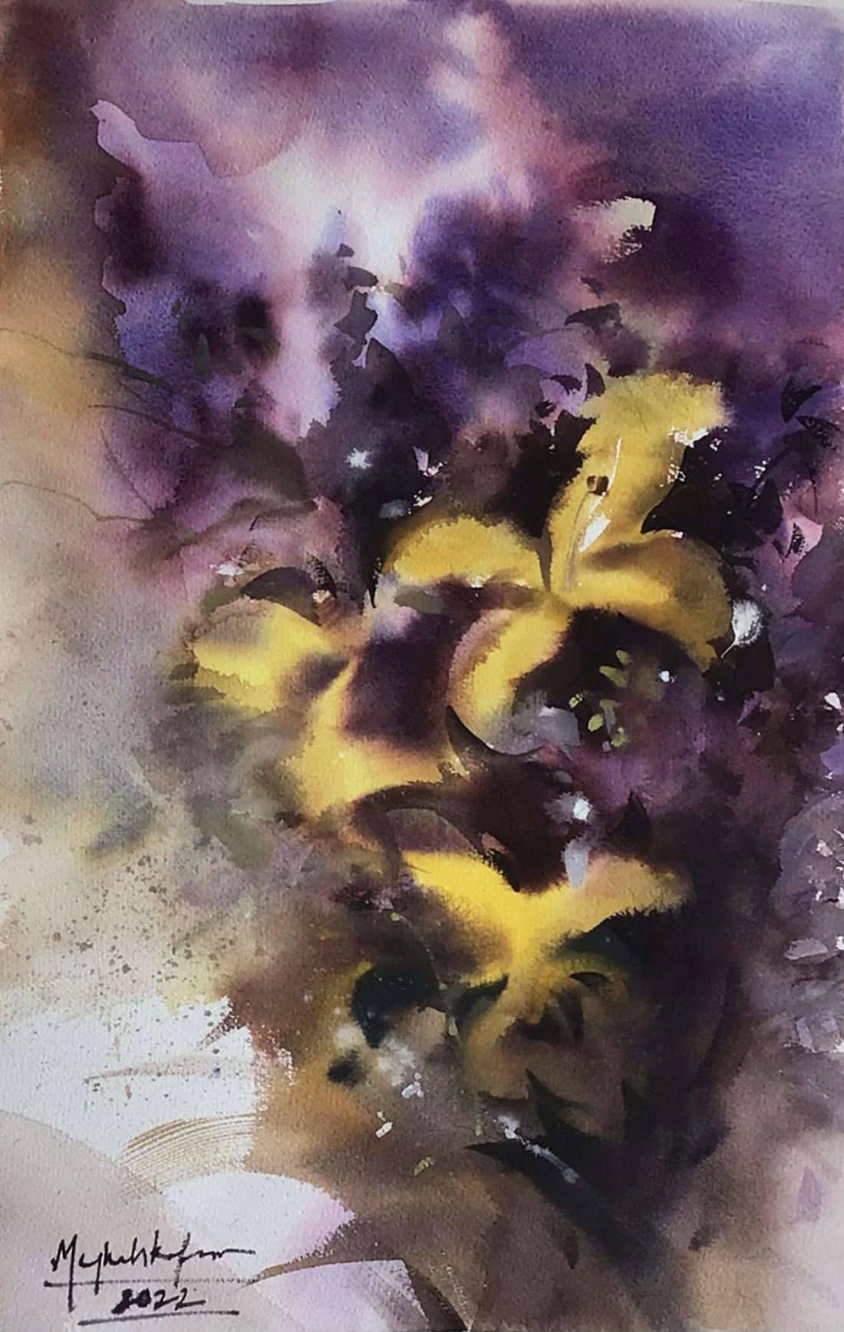
Learning to see
First thing that should come to your Mind is
Don’t copy …..Interpret
Just don’t copy the scene you just have to feel as if it was made out of Paint

Slide 3
Be Bold and Clear. What do you want to say and why ?
Be simple ( if you want to interpret a strong painting)
Thing about your Focal point, thing about your design first and story later.
First thing is Which areas are the Darkest/Lightest
Coolest / Warmest
Dullest /Richest
Active / Quiet

Slide 4
PAINTING CONSIST OF ..
Composition
Shapes
Colors
Values
Edges
Feeling and Brushwork are also very significant.

Slide 5
Composition
Thing about the Focal point
Design , leading lines
Rule of thirds, odds
Different kinds of Composition are there L, A, V
Thing about Foreground, Middleground, Background.
Perspective and Color perspective (things at distance will be cooloer )

Slide 6
SHAPES/ DESIGN
Divide everything into shapes while drawing.
Outline the scene in your mind, it really helps
Bigger shapes first, then smaller
Shapes of different sizes makes the scene more interesting.

Slide 7
Colors
Colors Harmony is very Important in every painting.
Try to add a Dominant color scheme in your painting.
Always include a little background in your foreground and vica versa
Paint color relationships nothing is isolated. A blue bowl will change its color when you add an orange in it.
Different plane, different color
The color of the Light + the color of the object = the true color mix
Color temperatures are very imp
Whenever there will be cool light, the shadows will be warm.

Slide 8
Values

Slide 9
EDGES
There must be a loose edge, a soft edge and a hard edge in your Painting.
The Hardest edge will be where you want to keep your Focal point.

Slide 10
LIGHT
Nothing in the Light is as Dark as Shadow.
Nothing in the Dark is as light as Light
Sunlight is Warm yellow to Red
Skylight is Cool green to purple
The color of the light is most revealing on White object
Warm light on warm object instensify and on cool object mute.

Slide 11
FEELING & BRUSHWORK
Try to paint the Mood of the Sunny Day, it will be naturally warm
Try to put your Soul inside every painting. Feeling is Everything.
When you have succeeded with expression. Stop!
Brushwork should be spontaneous

Slide 12
PROCESS
Shapes, Large Value Values, Color Harmonies
Draw connecting the Negative areas.
Dominant color, temperatures

